Slide 1
Have Your Pi and Eat It Too: .NET Core on Raspberry Pi
Cam Soper
Microsoft

Slide 2
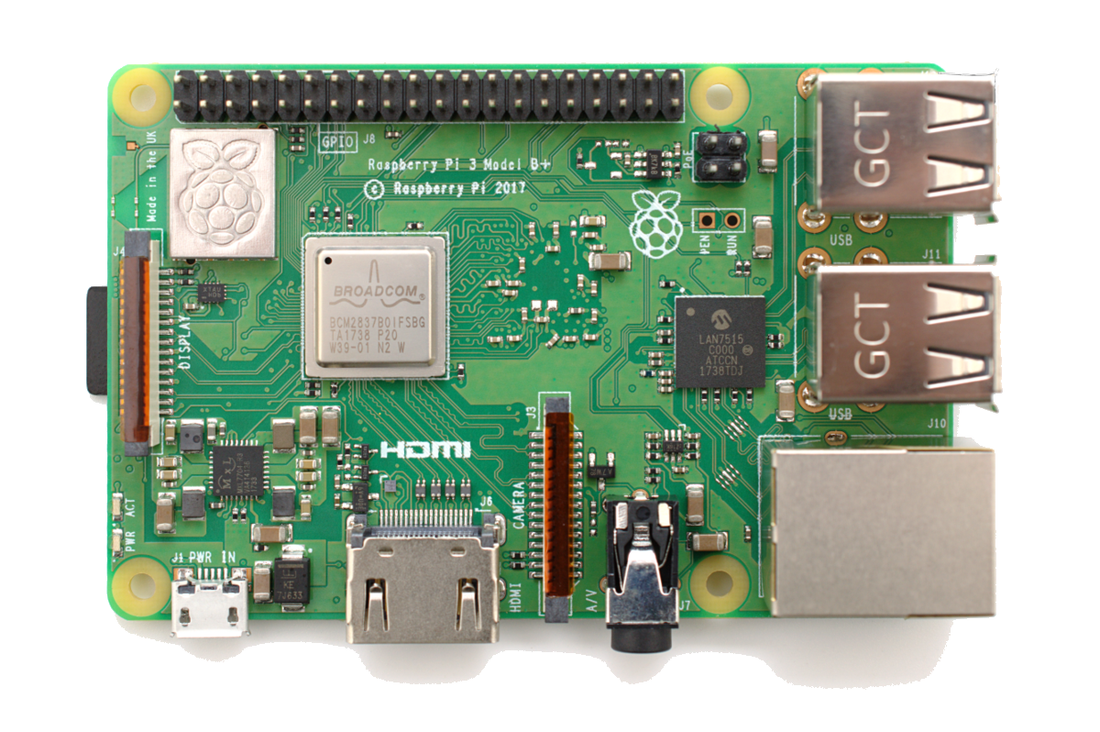
What we’ll cover
The basics
Development
Deployment
Debugging
GPIO
Control an LED
Control a reversible motor
Read temperatures
Cloud integration
Display text on an LCD with Cortana

Slide 3
The Basics The berry beginning…

Slide 4
Demo: Building, Deployment, and Debugging

Slide 5
GPIO Putting the “things” in IoT

Slide 6
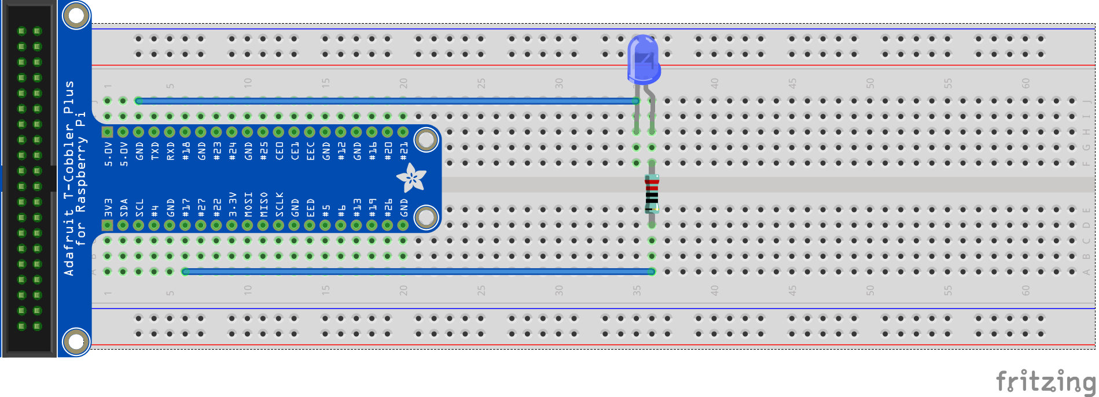
Hello world (LED)
Ground
GPIO 17

Slide 7
Demo: Hello World (LED)

Slide 8
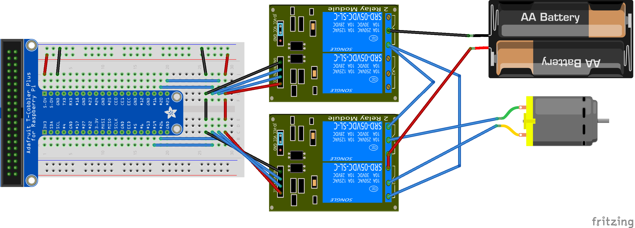

Reversible motor
GPIO 20
Negative
Positive
GPIO 19
Positive
Negative
GPIO 26

Slide 9
Demo: Motors

Slide 10
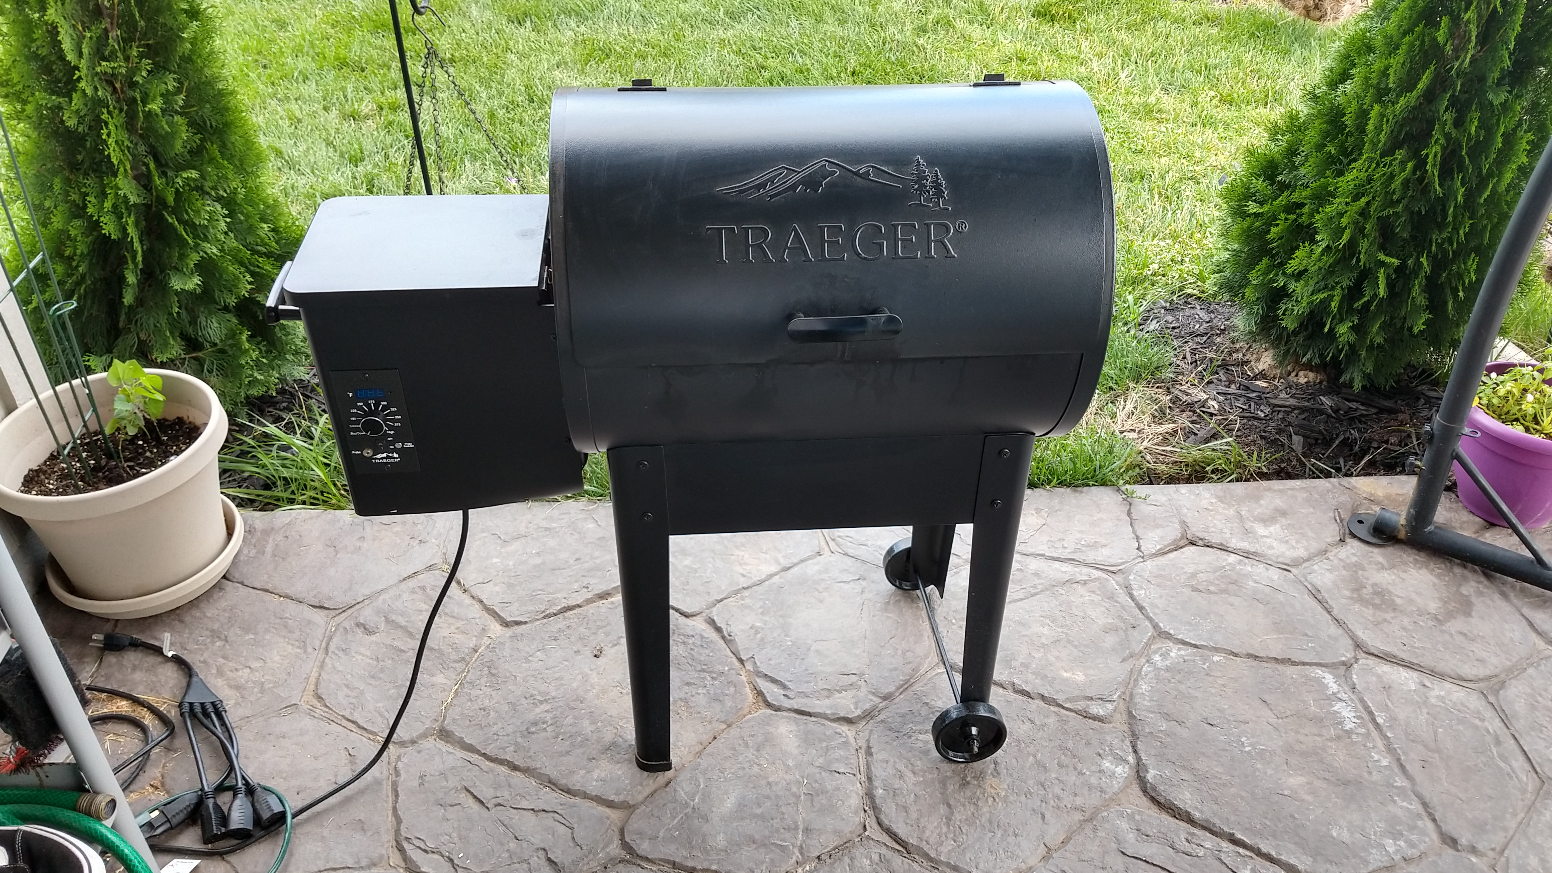
Notes:
https://github.com/camsoper/inferno

Slide 11
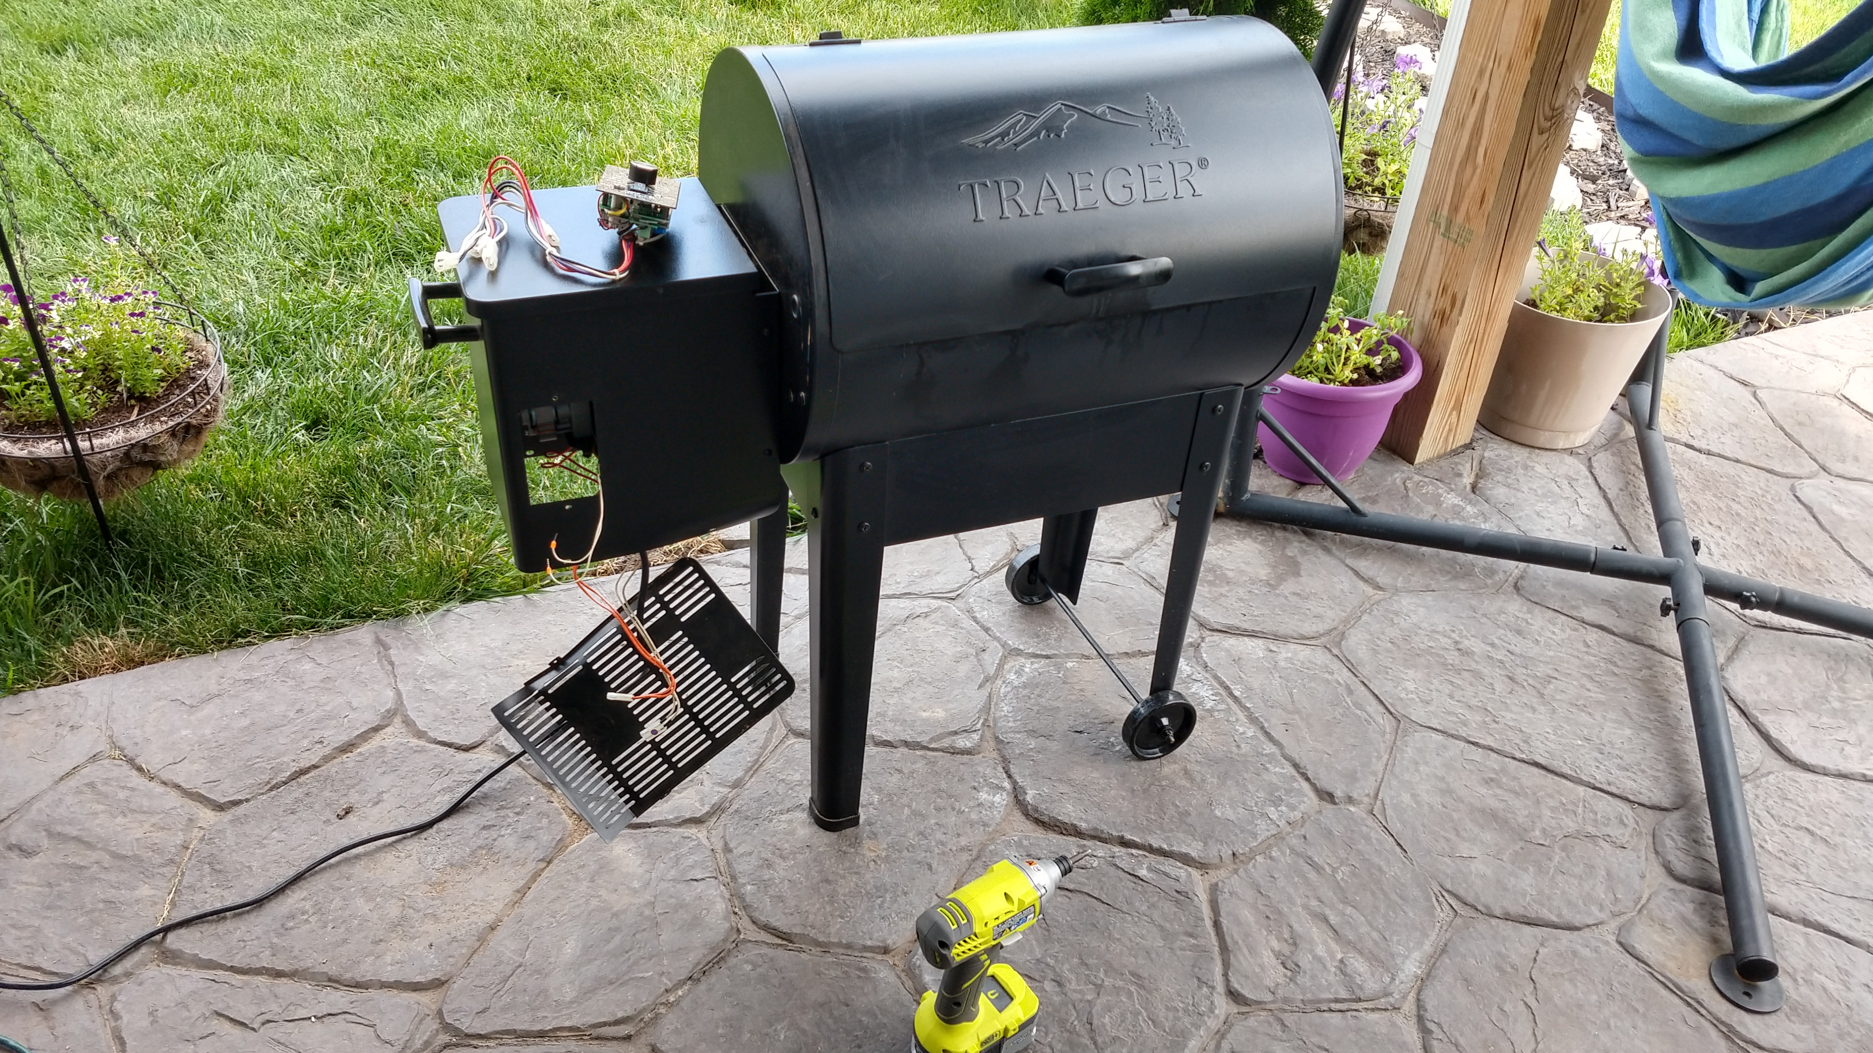

Slide 12
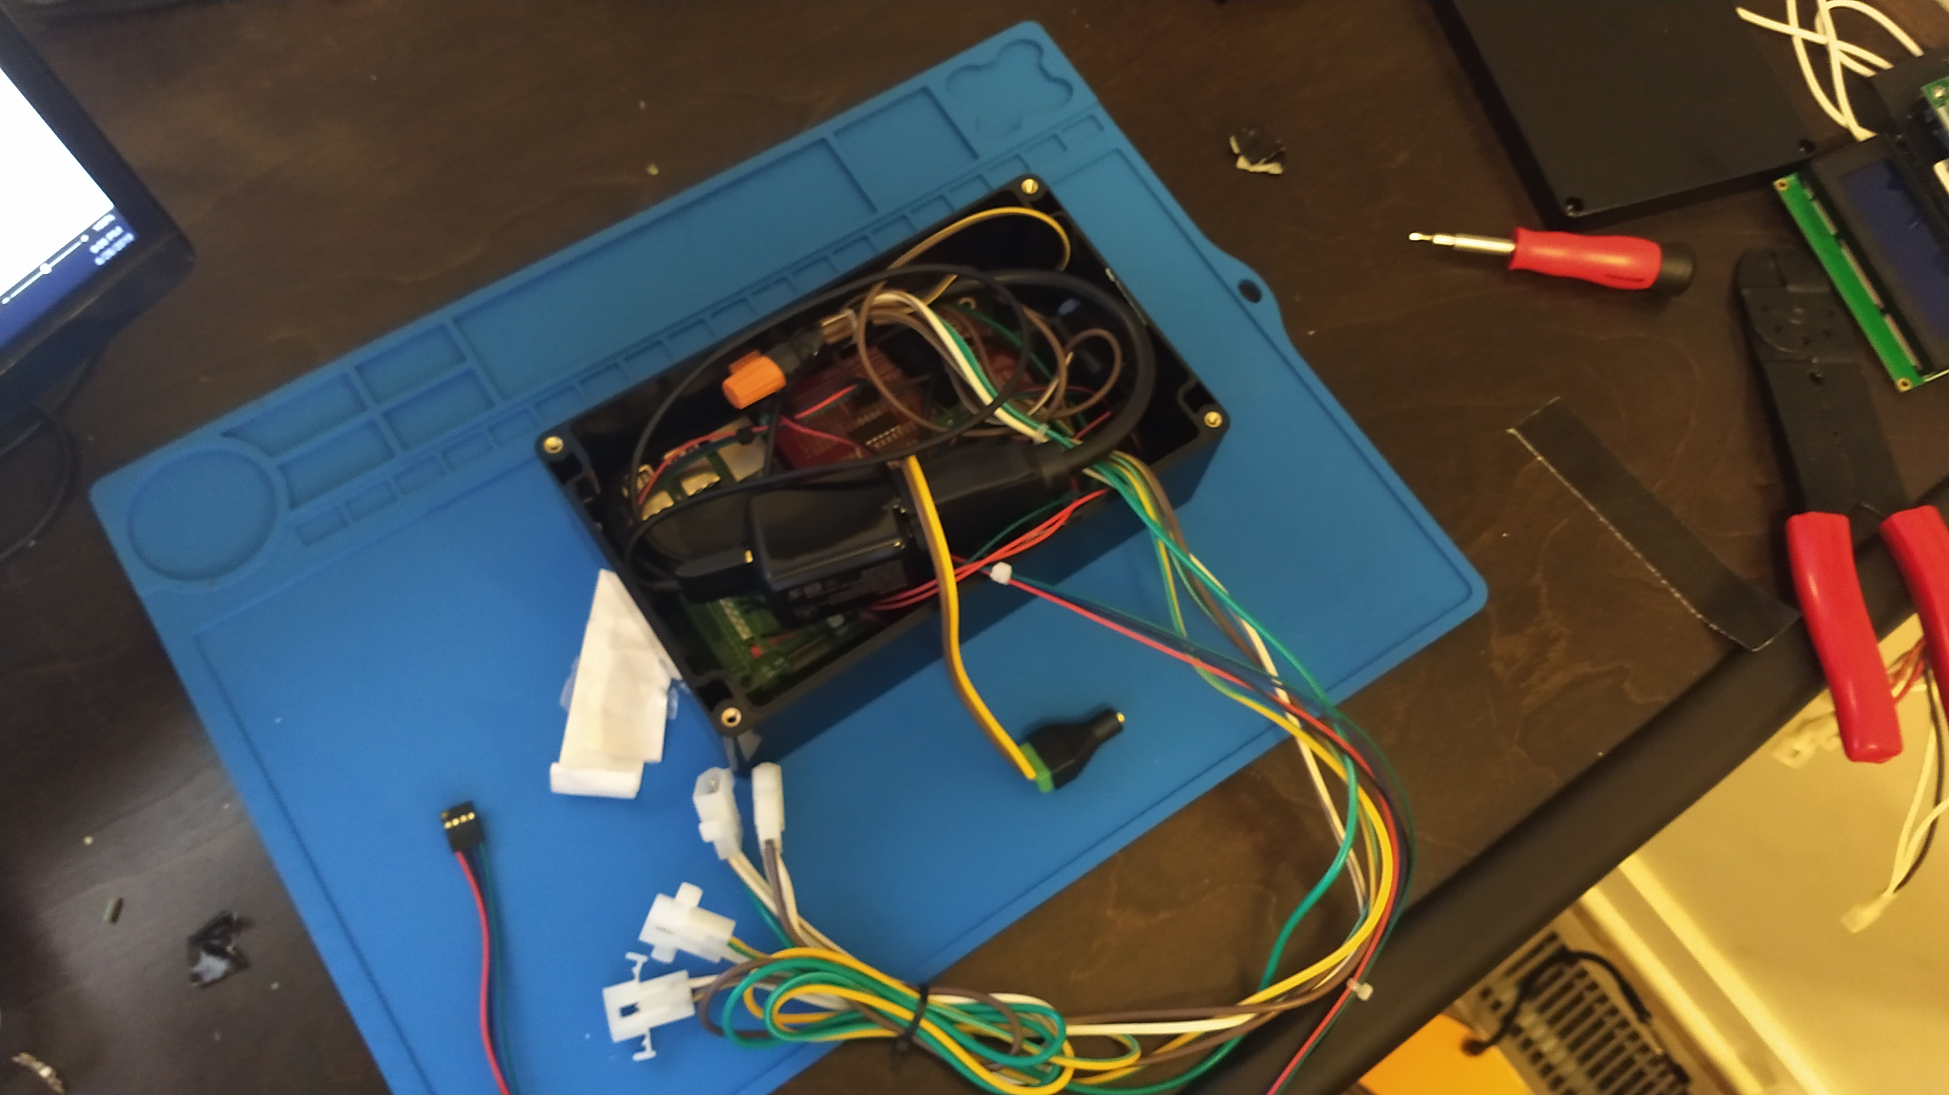

Slide 13
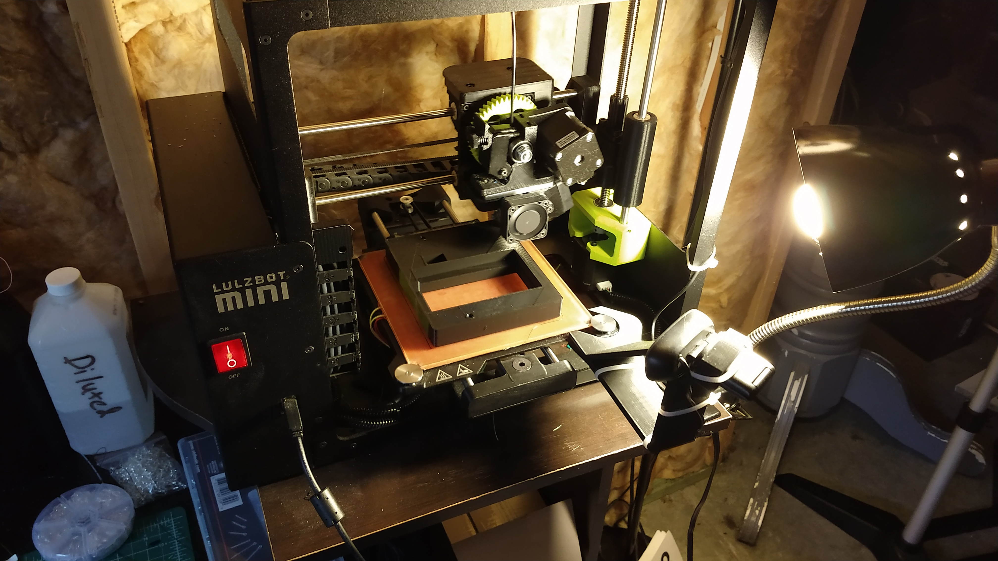

Slide 14
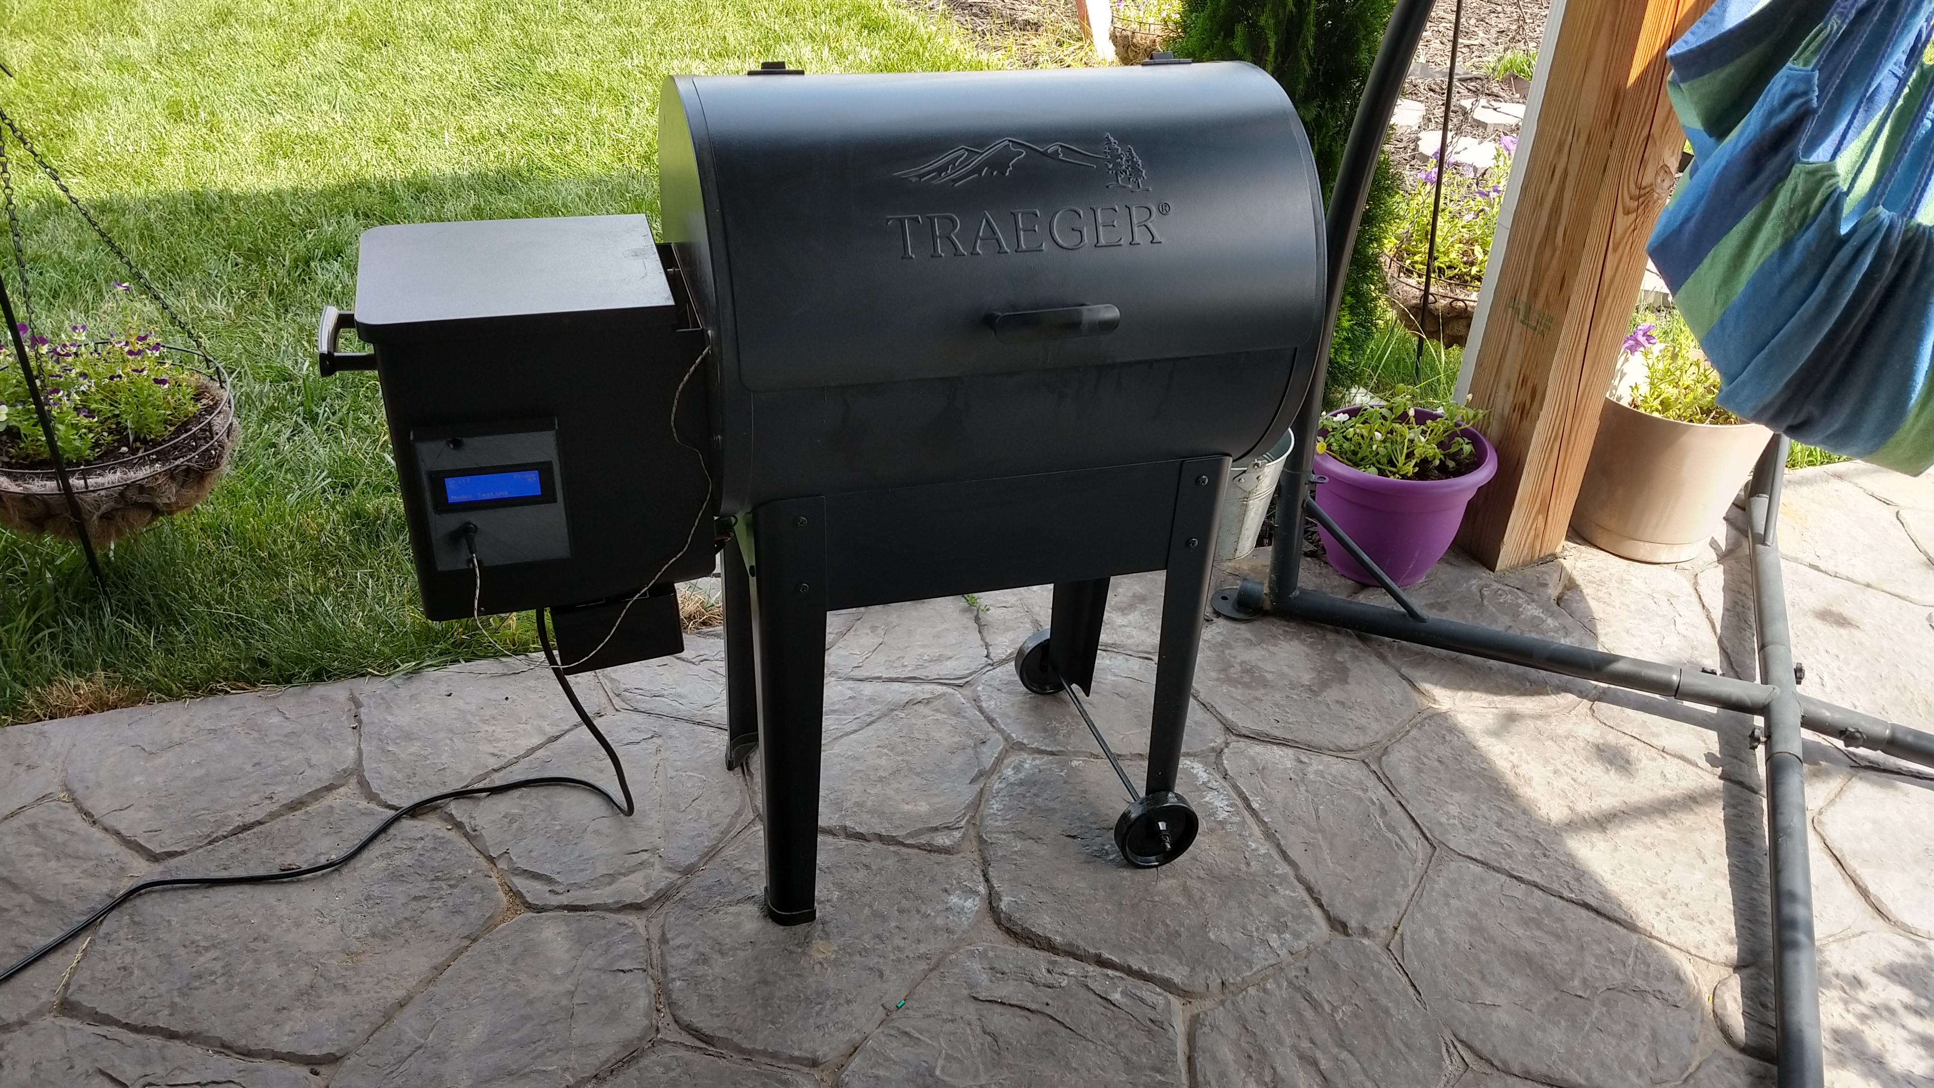

Slide 15
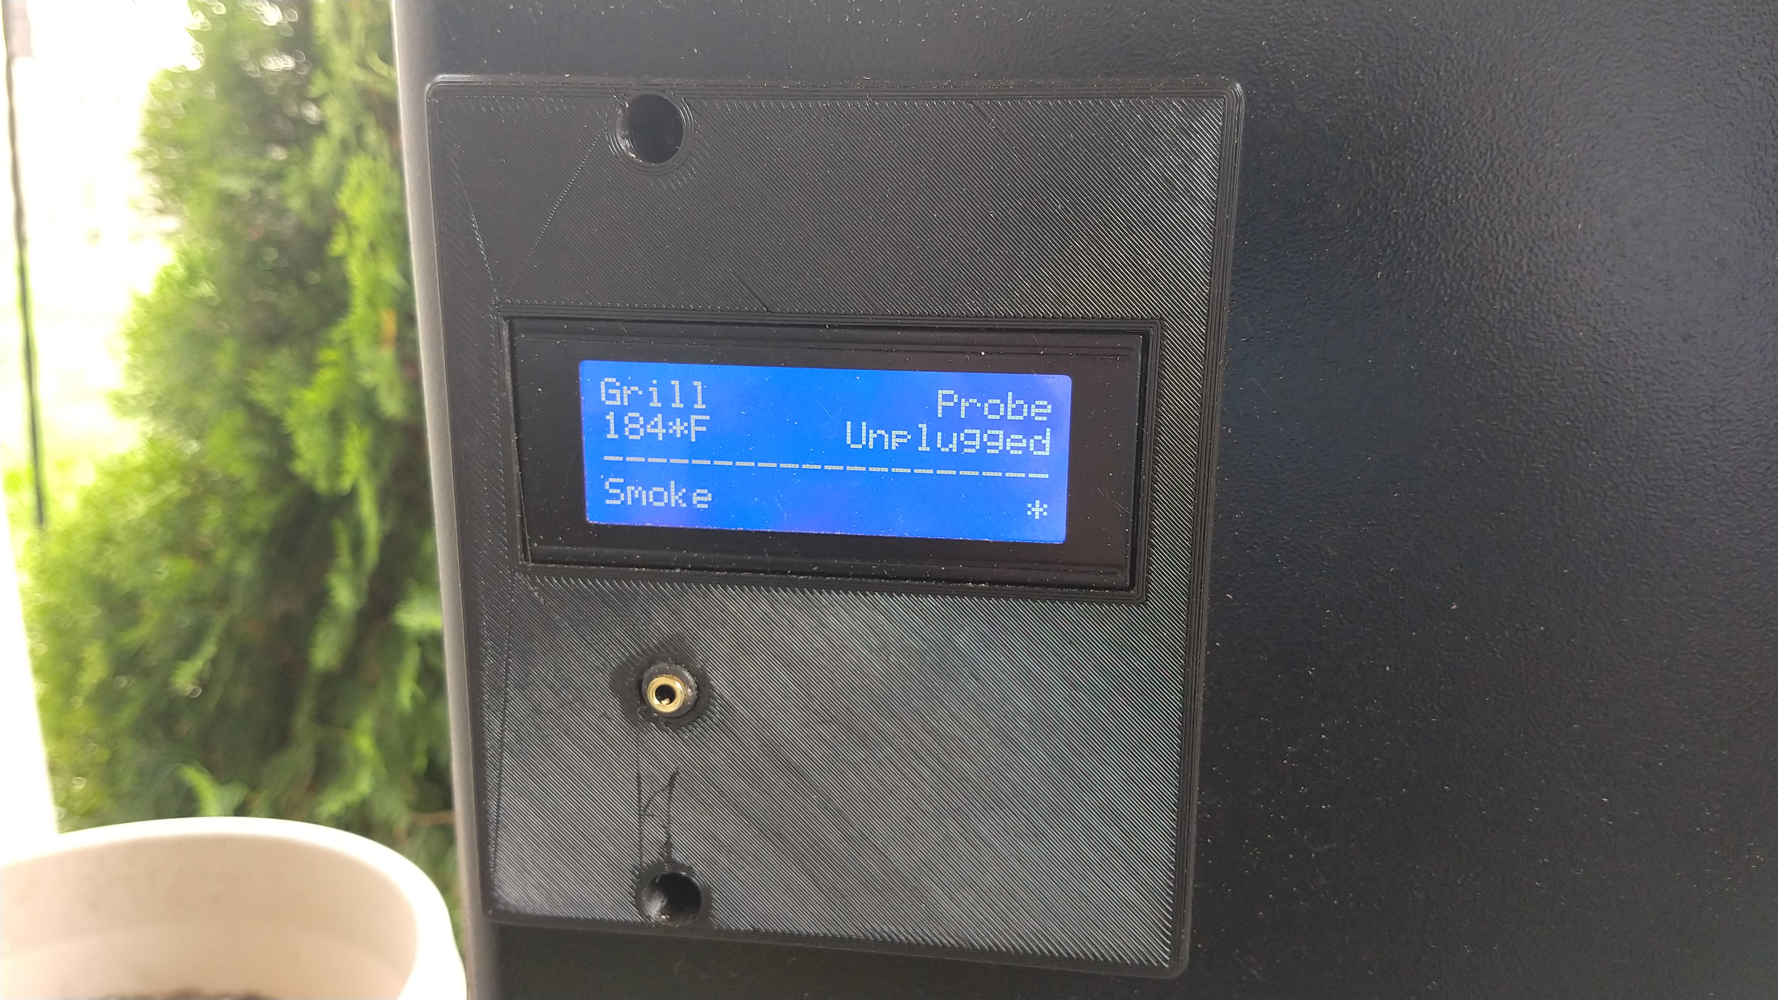

Slide 16
Demo: RTD

Slide 17
Using the cloud to do neat stuff What’s IoT without the Internet?

Slide 18


Easy Cortana Integration
Hey, Cortana…

Slide 19

Easy Cortana Integration
Hey, Cortana…

Slide 20
Demo: Easy Cortana Integration

Slide 21
What’s next?

Slide 22
What to look at next
https://github.com/camsoper/have-your-pi
Notes
Demos
Slides
Schematics
.NET Core IoT Libraries
Prerelease, targeted for .NET Core 3.0
Designed for several IoT platforms (Raspberry Pi included)
Supports all the functionality demonstrated here
The team is looking for contributors! Visit: http://github.com/dotnet/iot

Slide 23



Thank you! @CamSoper CamSoper
CamDoesCoolStuff

